Slide 1


PROJECT REVIEW -2
Control and Management of Railway System Connected to Microgrid Stations​
Under The Esteemed Guidance Of​
Dr. K. Chithambaraiah Setty _{Ph.D.}​
HOD(EEE) & Vice-Principal​
BY​
BUGUDI MOHAN KUMAR -> 20G31A0207​​ MALIREDDY LAKSHMAN -> 20G31A0215​​ SEELAM RAJASEKHAR -> 20G31A0221​​
BOYA RAMAKRISHNA -> 20G31A0205 M FAREED AKRAM -> 21G35A0215​

Slide 2

ABSTRACT
INTRODUCTION
LITERATURE SURVEY
BLOCK DIAGRAM
WORKING PRINCIPLE
SIMULATION RESULTS
CONCLUSION
FEATURE SCOPE
CONTENTS

Slide 3
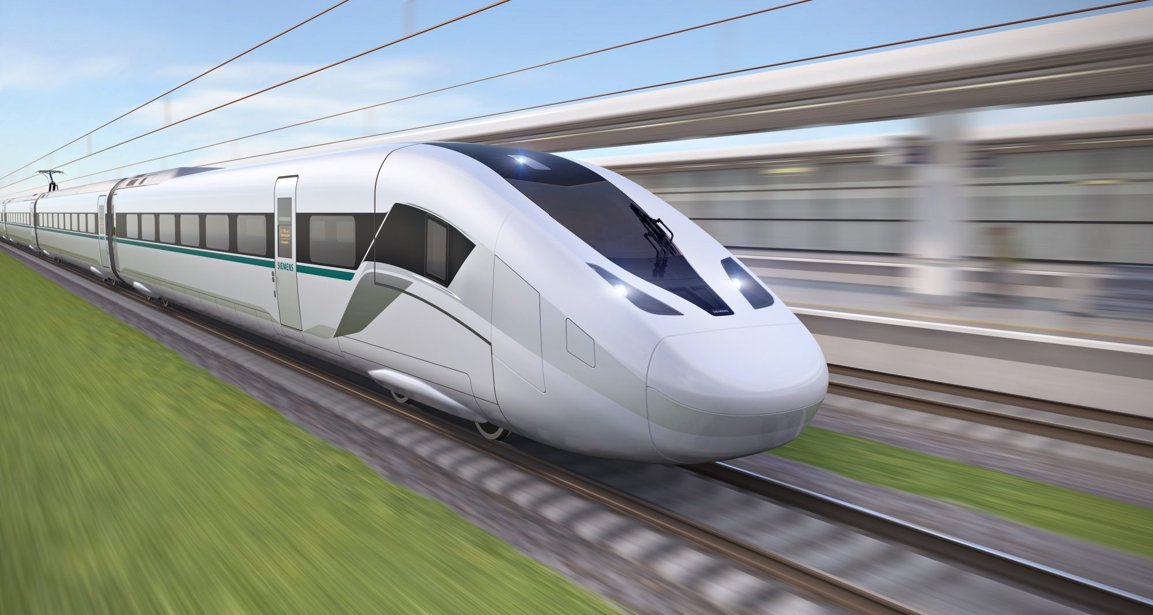
The proposed design of railway station use PV and wind sources, and batteries for energy storage system (ESS).
For the train, SCs are implemented to the ESS where they are alimented breaking phases and from stations by a pantograph installed in an air power line in each stop.
SCs are distinguished by high characteristics power and a wide number of charge/discharge cycles.
They provide low particular energy and a fast charging time.
An energy management approach is suggested to control the DC bus voltage and the buck-boost converter for current.
Simulations for the train and station show the suitability of the suggested powertrain and control strategy.
ABSTRACT

Slide 4
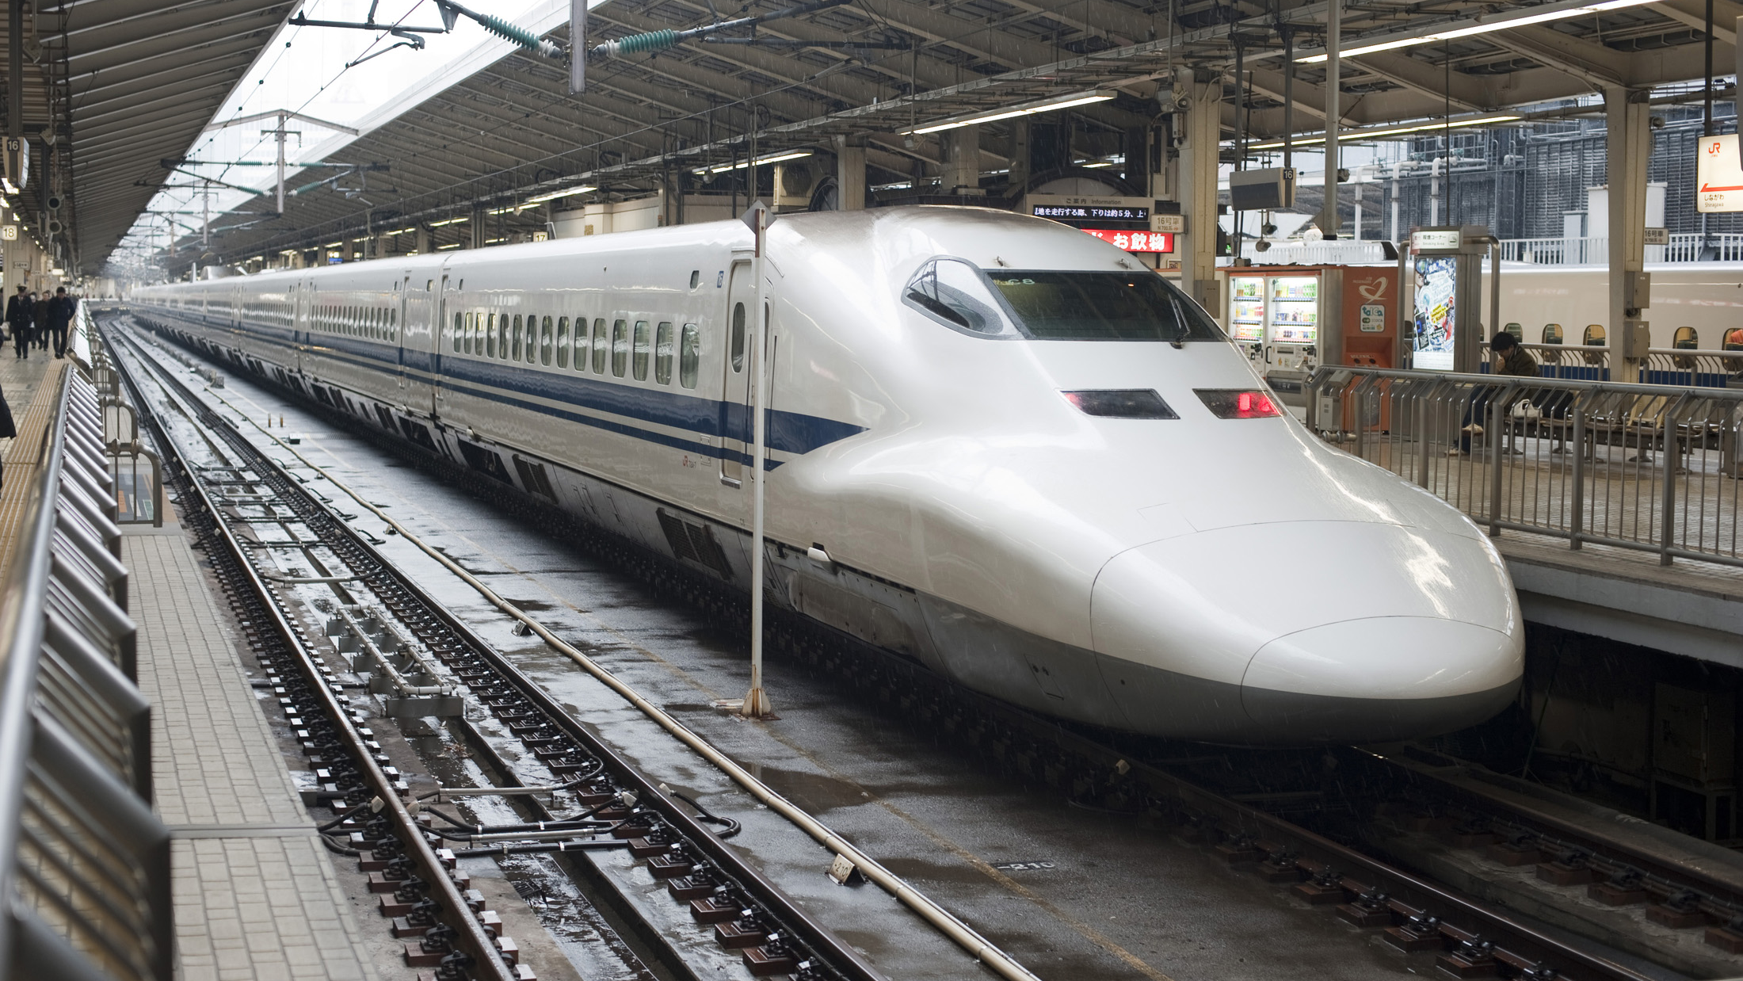
In the last few decades, generally there is a major growth in energy utilization and pollutions.
The growing number of citizen traveling between cities has implied the continuous development of mass transit systems as buses, taxies, and trains.
However, the use of railway transportation systems other conventional means of transport is widely recognized due to the Carrying capacity of a large number of people.
The development of rail transportation allows people to travel quickly. Thereby, growing environmental issues like climate change and CO2 emissions.
For these reason the electric railway traffic has become a principal development and management of current public transportation networks.
INTRODUCTION

Slide 5
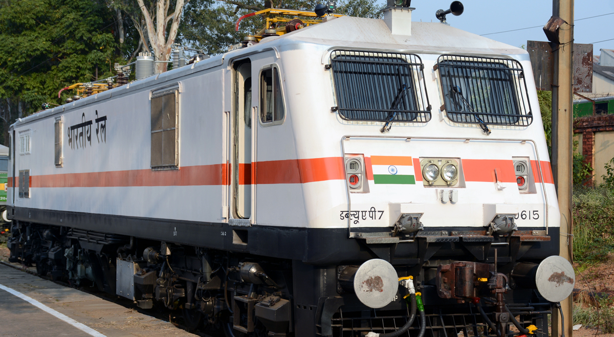
The railway system has been studied successfully in many articles by researches such as:
Jiang presents a fast inspection method for high-speed railway infrastructure monitoring.
Feng gives the electric railway smart microgrid system with integration of multiple energy systems and power-quality improvement.
Khayyam gives railway system energy management optimization demonstrated at offline and online case studies.
Zhang presents the method using a prediction approach, He shown the energy harvesting approach for railway wagon monitoring sensor with high reliability and simple structure.
Sun presents the hybrid method for life prediction of railway and Novak presents the hierarchical model predictive control for coordinated electric railway traction system energy management
Sengor gives the energy management of a smart railway station considering regenerative braking and stochastic behavior of ESS and PV Generation.
LITERATURE SURVEY

Slide 6
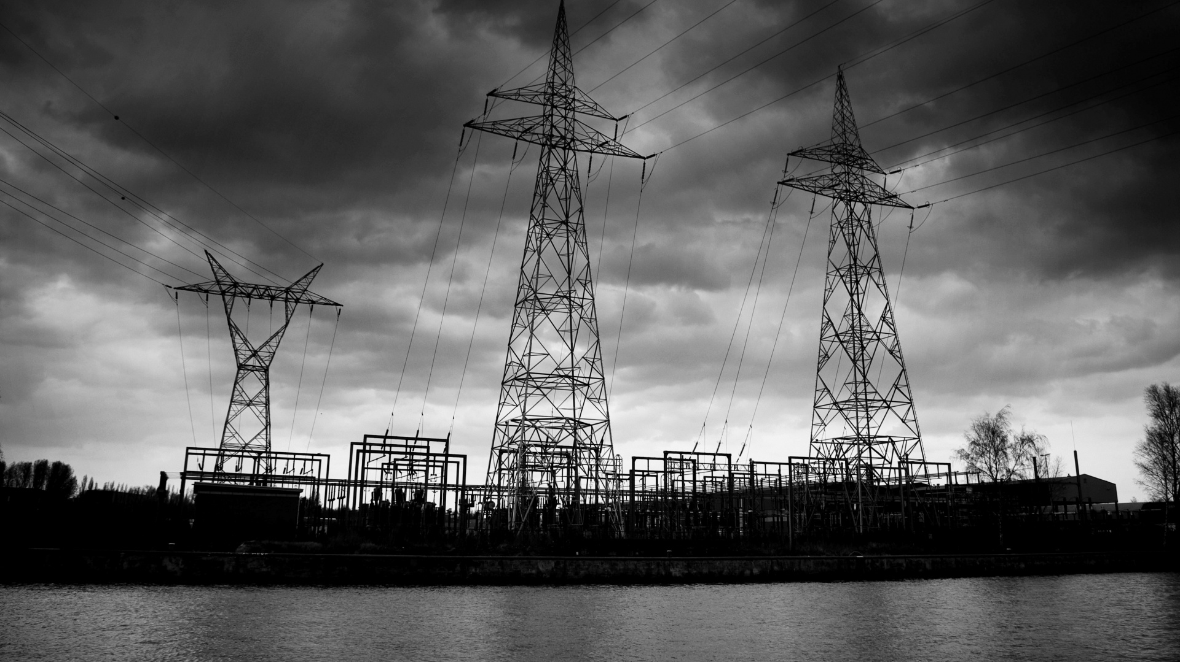
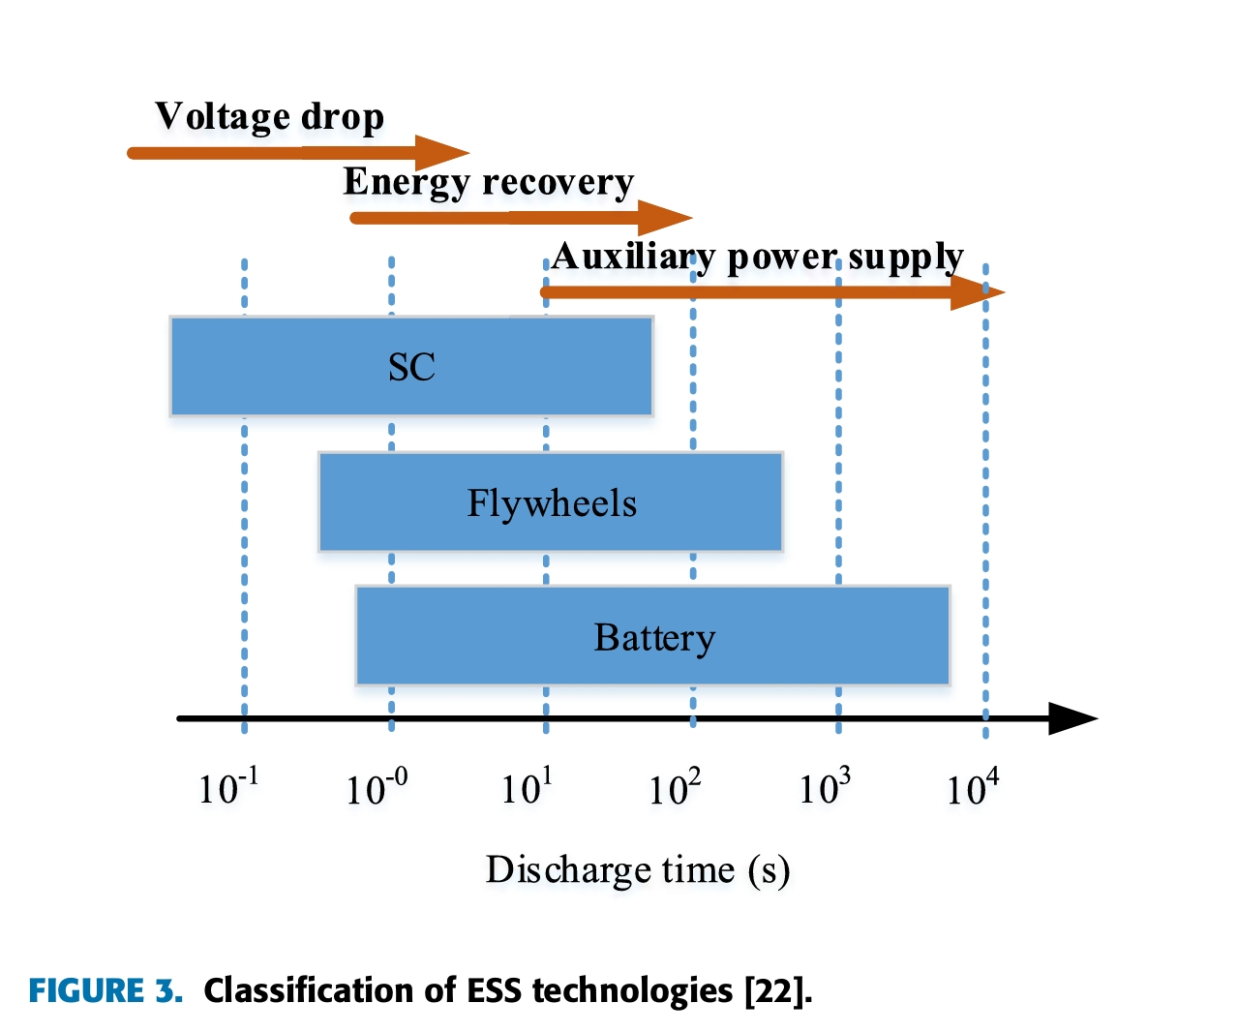
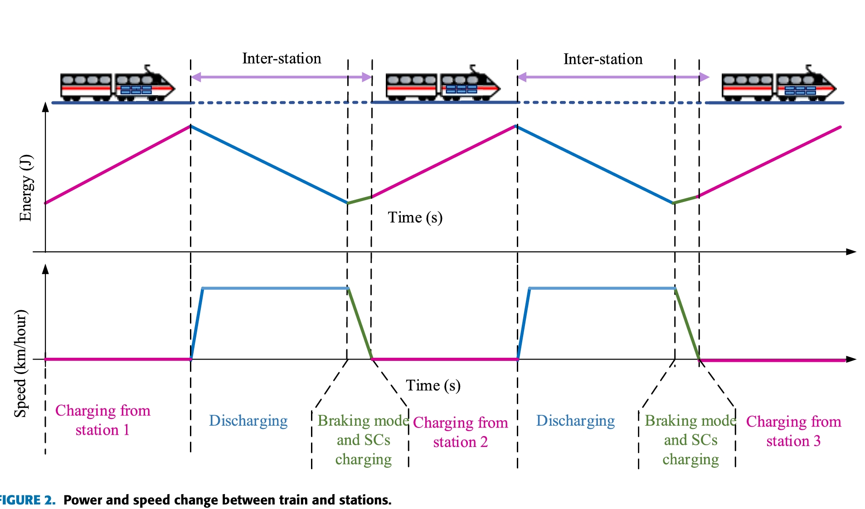
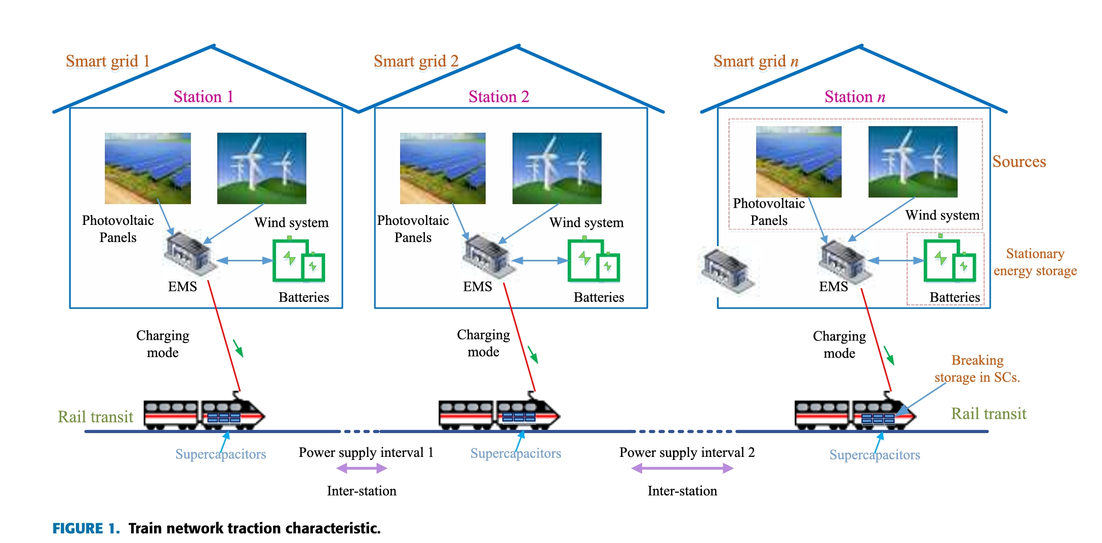
PROJECT DIAGRAMS

Slide 7

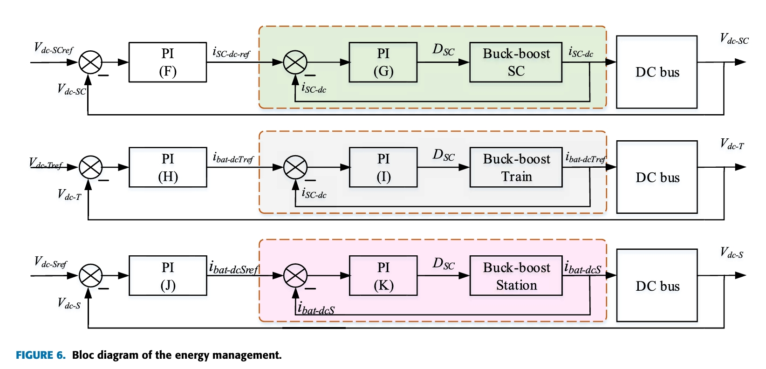
WORKING PRINCIPLE

Slide 8
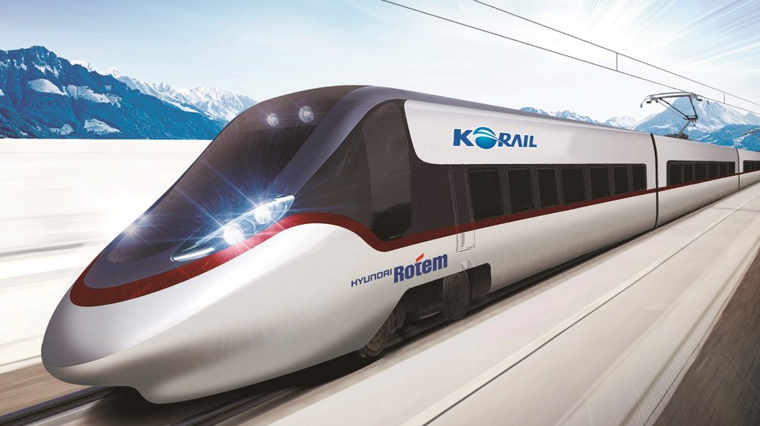
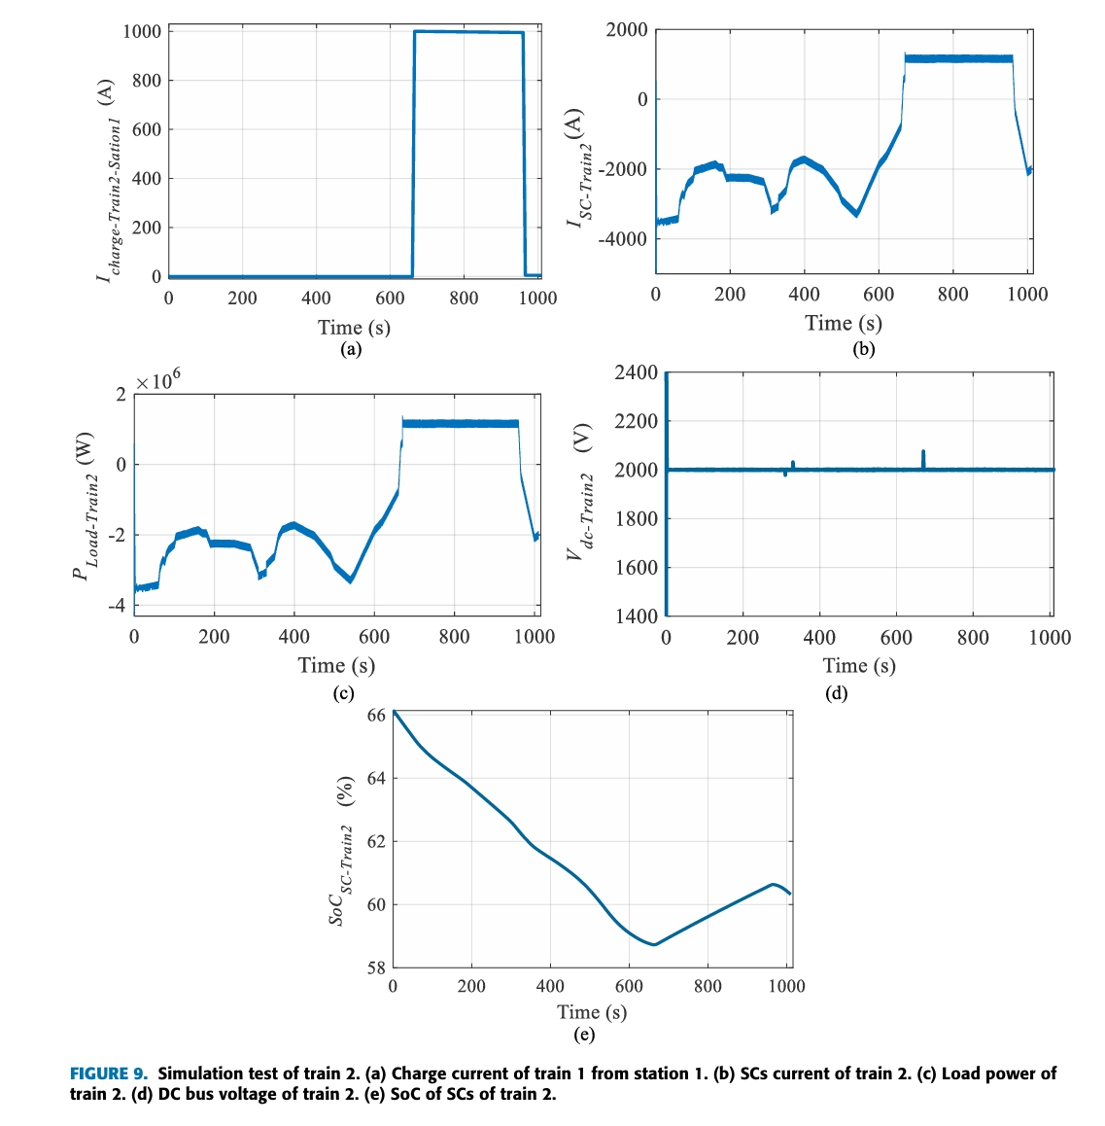
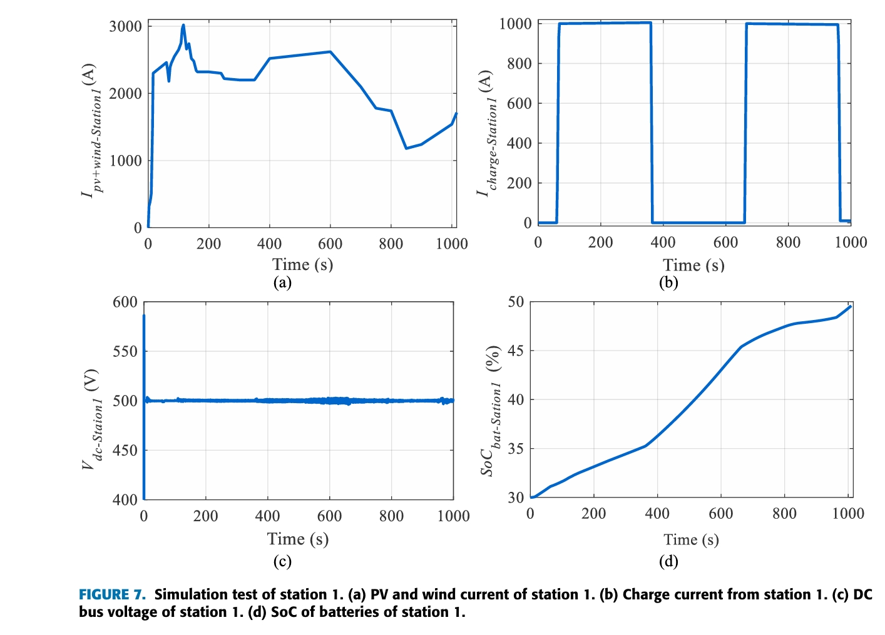
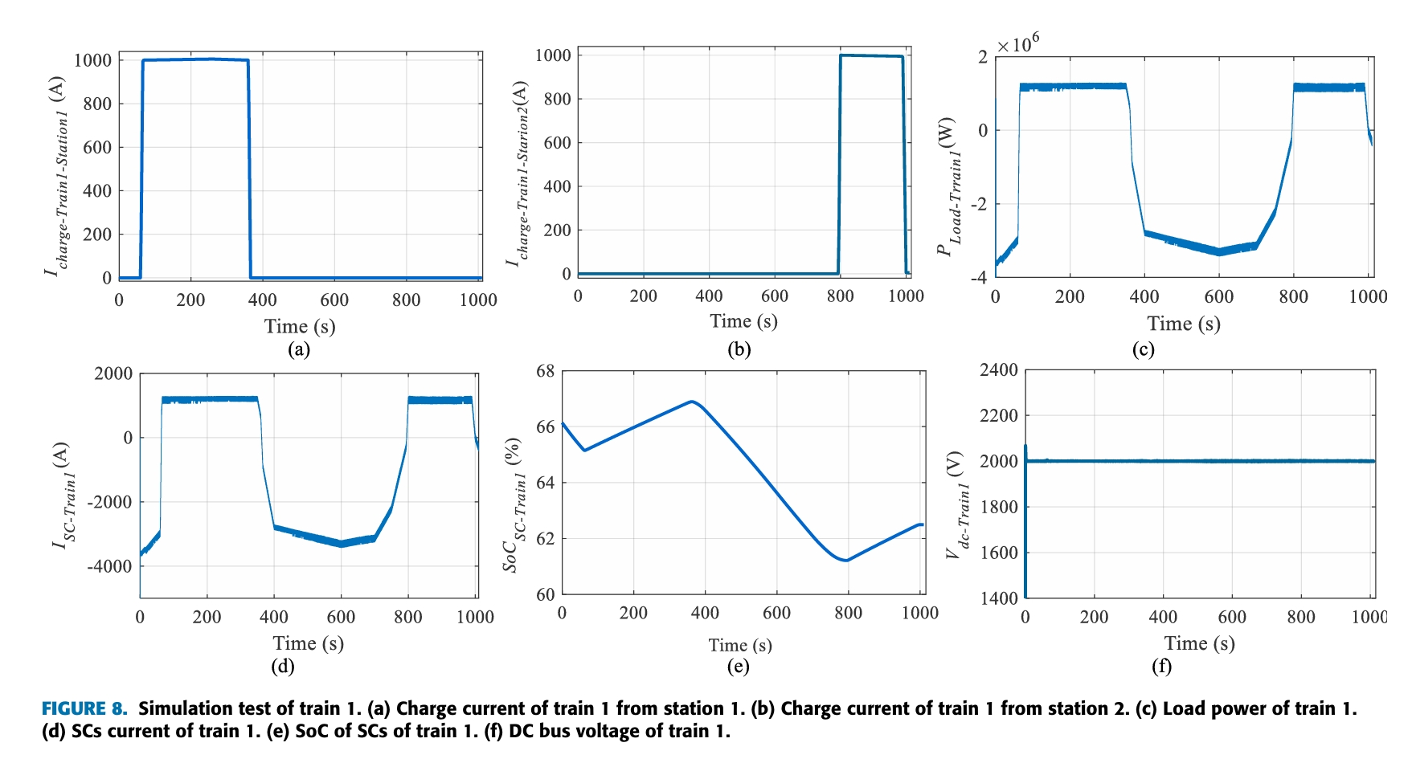
SIMULATION
RESULTS

Slide 9
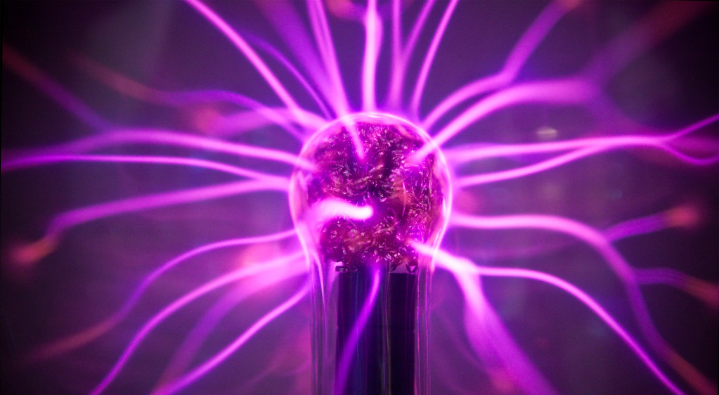
The proposed techno-economic method for the energy storage by using SCs in the train is presented in this project review.
The studied system is devised on two parts: station and train.
The design of railway station is presented by using PV and wind as principal sources, and batteries for ESS.
The train is composed by engine and SCs.
SCs are used for their fast charge and discharge.
An EMS is given in order to stabilized the DC bus.
. A simulation test was proposed with one station and two trains. The trains recharge from the station in different times.
CONCLUSION ​

Slide 10

The methodology discussed in this project has It's Future scope as follows
This similar method can be used for the Electric Vehicles.
This method can also be implemented in the metro stations
FUTURE SCOPE

Slide 11


